Slide 1

System Design

Slide 2
Index
System design – 3
Monolithic vs Microservice – 5
Non-functional Requirement-7
CAP Theorem - 12

Slide 3
What is System Design?
A system is a set of interconnected components working together to achieve a common goal, while system design is the process of defining and implementing the architecture, components, and interfaces of a system to fulfill specific requirements.
High Level Design(HLD) : describe system architecture details, database design, service and processes, relationship between different modules and features.
Low Level Design(LLD) : describe design of each component in detail, classes , interfaces , relationship between them, and various actual logic of different components.

Slide 4
System design requirements
Non-Functional Requirements:
These specify the quality attributes, constraints, and characteristics that the system must possess, beyond its core functionality.
Non-functional requirements address aspects such as performance, reliability, security, usability, scalability, maintainability, and compatibility.
Functional Requirements:
These describe what the system should do and define specific functions, features, and behaviors that the system must exhibit.
Include user authentication, data validation, report generation, transaction processing, and user interface interactions.

Slide 5
Monolithic vs Microservice Architecture
Web Application = frontend + backend + database
Monolithic Architecture: Entire application is built as single, self-contained unit all of its components(UI, db, business logic) are tightly integrated and deployed together.
Microservice Architecture: Application is decomposed into smaller, independently deployable services, each responsible for specific business function or feature. Each microservice runs as specific process and communicates with each other through well defined API’s.

Slide 6
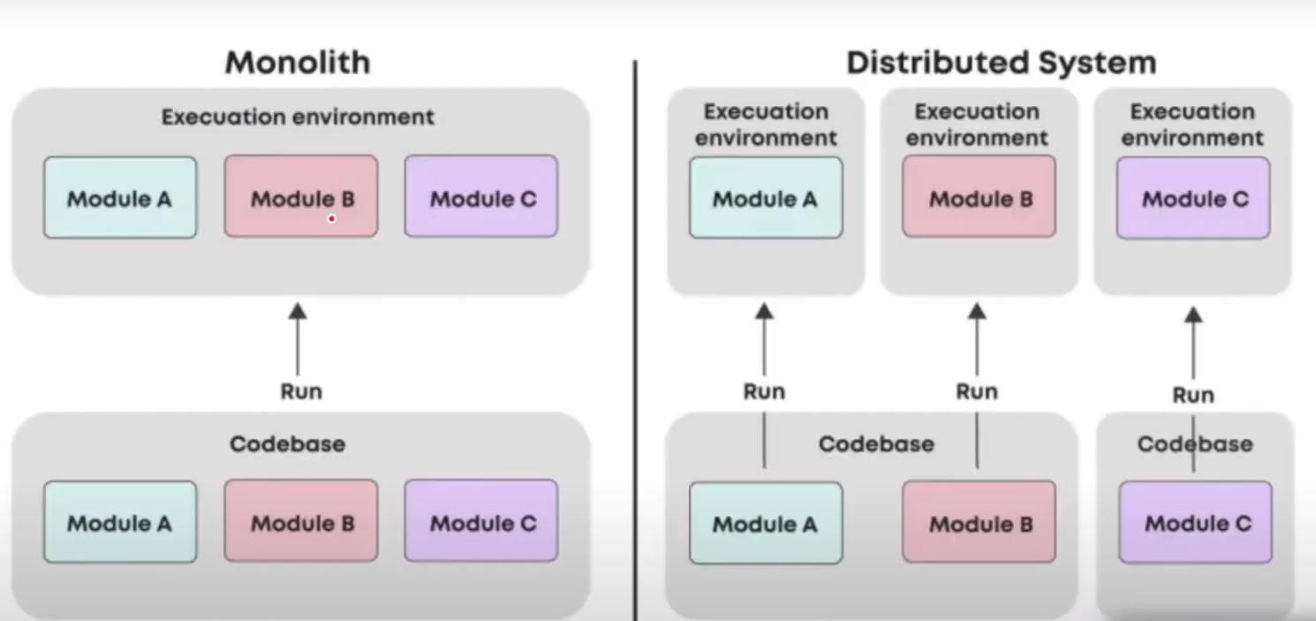
Notes:
Monolithic is faster, since all modules are present in single system, so network calls between systems is lesser compared to microservice.
But monolithic architecture has single point of failure, also hard to scale and debug
If single module is updated in monolithic architecture, whole system needs to be deployed again

Slide 7
Non-functional Requirements Availability
Availability in system design refers to the ability of a system to remain operational and accessible to users, typically measured as a percentage of time that the system is functional and responsive.
Measured in percent, 99.9%(3 nines) means it is available for 99.9% time.
Monolithic system have single point of failure, and hence are less available.
Ways to improve Availability:
Redundancy ( server, network storage etc copies)
Failover strategies
Disaster recovery
Load balancing
Monitoring and alerting system

Slide 8
Consistency
Consistency in system design refers to ensuring that all copies of data across different components or nodes in a distributed system are synchronized and up-to-date
Types of Consistency:
Strong Consistency: System does not allow read operation until all nodes with replicated data are updated.
Eventual Consistency: Some users might receive old data, but eventually all data gets updated to latest data, read request re not halted.
Weak Consistency: Here it is not necessary to have same data in all nodes.

Slide 9
Partition Tolerance
Partition tolerance in system design refers to a system's ability to continue functioning and providing services even if network partitions occur, causing communication failures between different components or nodes of the system.
In distributed systems, network partitions can occur due to various reasons such as network failures, hardware failures, or geographical distribution of components. When a partition occurs, the network is divided into separate segments, and communication between nodes in different segments becomes unavailable or unreliable.
Achieving partition tolerance is crucial for ensuring the resilience and fault tolerance of distributed systems, particularly in environments where network connectivity cannot be guaranteed at all times. Partition-tolerant systems are designed to handle network partitions gracefully and continue operating without compromising data consistency or availability.

Slide 10
Latency
It refers to time it takes for data to travel from its source to its destination.
request
User computational delay
response
Latency = computational delay + network delay(b/w user and system + within components of system)
For monolithic system internal calls are lesser and hence latency is less.
Ways to reduce latency:
Implement parallel processing
Use Caching
CDN
Compere
Upgrading hardware and processing devices
server

Slide 11
Throughput
In system design, throughput refers to the rate at which a system can process and handle a certain volume of work within a given period of time.
Measured as amount of data transferred per unit time. Eg megabytes per second(mbps), kilobytes per second(kbps)
Ways to improve throughput:
Caching
Optimizing algorithm and data structures
Parallel processing
Improve network performance
CDN
Upgrading hardware and processing devices

Slide 12
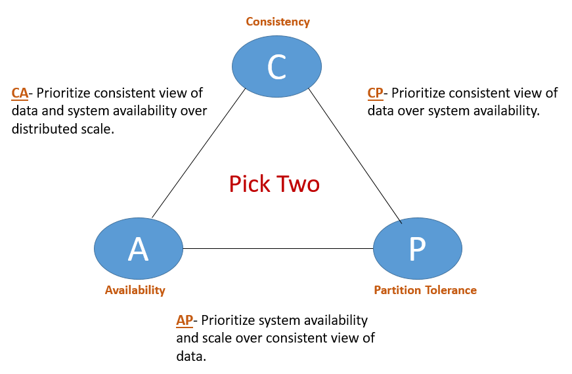
CAP Theorem
The CAP theorem states that in a distributed system, it is impossible to simultaneously achieve consistency, availability, and partition tolerance; instead, systems must prioritize two of these properties at the expense of the third.
In real world no one compromises Partition tolerance, as all system should still work in case of failure and all distributed system must be tolerant to it.
So choice comes down to consistency and availability.

Slide 13
Examples of CAP theorem in real world
1. We usually see bank servers and apps like gpay stop working again and again cause they needs to have consistency, therefore they compromises with availability.
2. Apps like Instagram, Facebook etc needs to be available all the time, so they compromises with consistency. Eg when you like a post in Instagram, the other user won’t instantly get the changes in like count. There is eventual consistency.
3. Games and video streaming platform needs to be available all the time, so they can compromise with consistency.

